Slide 1
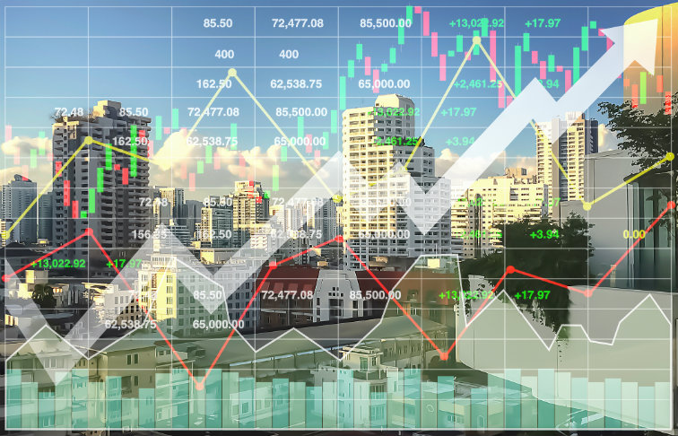
A project to predict the value of apartments

Slide 2
student
Yarin Ben Baruch – 209040757
Github → view project

Slide 3

Can we predict an increase in the value of an apartment ?
Is it a better neighborhood for residence or investment?

Slide 4
Stages of the project
Step 1- Scraping
I divided the crawling into 4 different neighborhoods.
Step 2 – Data handling
Step 3 - EDA
Step 4 - Model
I came across blocking attempts.
I used BS && Selenium.
The data were taken from the Madlan website.
Each data frame was about 1000 rows.
I analyzed each neighborhood individually.
I removed outliers , missing values and signs .
I changed the values to numeric.
In the data frame of the neighborhoods properties, I changed them all to a rating between 1 and 10 .
I used Skater Plot for each neighborhoods that displays the price according to the year.
I presented the distributions of the neighborhoods columns .
I presented a comparison of rentals .
I presented the neighborhood rankings.
I built a linear regression model .
I made changes to the model, to improve its prediction.
I presented a visualization of the model prediction versus reality.
I built a function for the user .

Slide 5

First step - scraping

Slide 6
So how did I do the crawling ?
What were the difficulties ?
The main difficulty was getting to know the selenium, because it was not possible to do a crawl with Beautiful Soup .
I handled the site blockages .
I made adjustments to the crawling function of each neighborhoods .
Using → Selenium & Beautiful Soup.
I took the data from Madlan website.

Slide 7
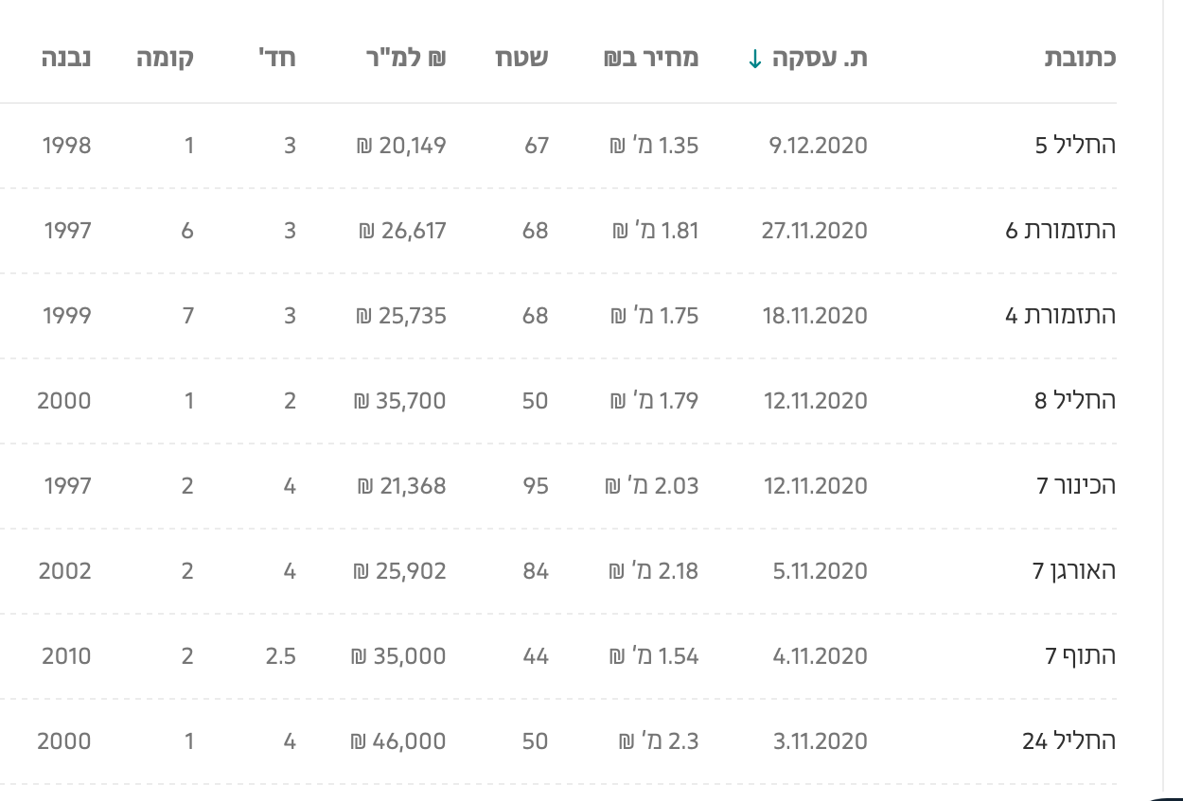
Example of a data frame

Slide 8
Data information
Data frame name | Number of Rows | Table columns
Ashelim | 1000 | Address , date , Square , num of rooms , Floor , year build ,Total price
Shikme | 1000 | Address , date , Square , num of rooms , Floor , year build ,Total price
Ramat Eliyahu | 1000 | Address , date , Square , num of rooms , Floor , year build ,Total price
Nahalat Yehuda | 1000 | Address , date , Square , num of rooms , Floor , year build ,Total price
Characteristics of the neighborhoods | 4 | School_grade, Socio_economic, Cleanliness_Maintenance, Kindergarten, Parking , Public_Transport , Feeling_confident, Gardens, Shopping, Pedestrian_comfort.

Slide 9

Step 2

Slide 10
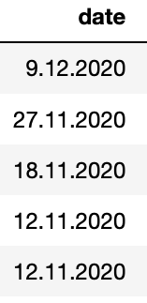
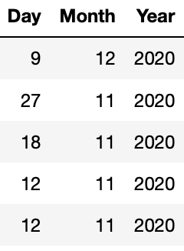

How did I handle the data ?
Let's start with changing the date
Remove missing data

Slide 11
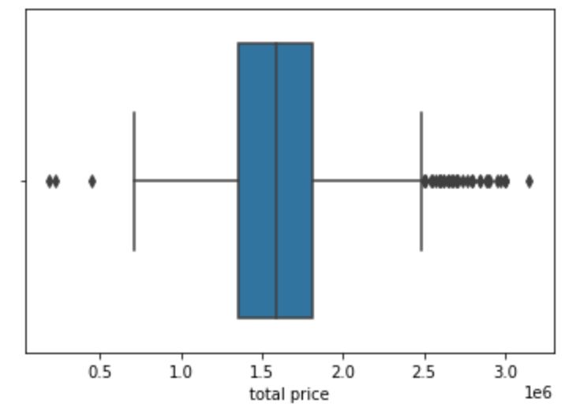
Drop outliers
For drop outliers I used IQR.
I decided to remove the right side which was over 3 million NIS.
On the left, I removed according to the visualization.

Slide 12
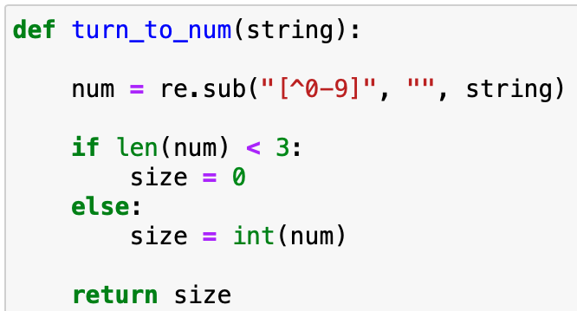
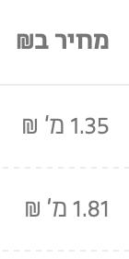
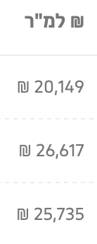
I removed marks from the prices

Slide 13
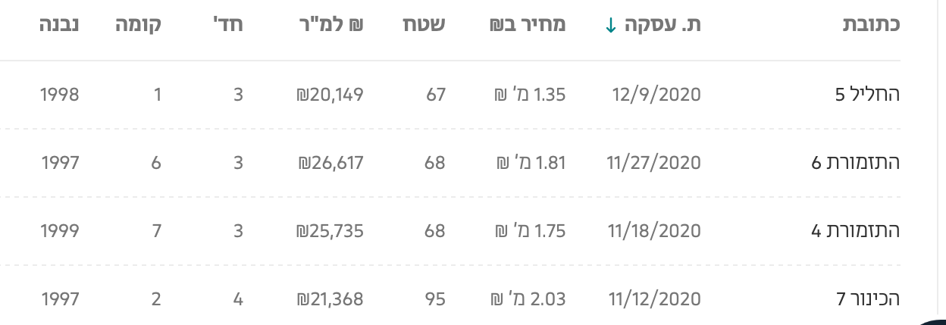
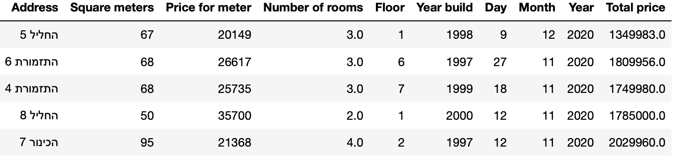
Before
After

Slide 14
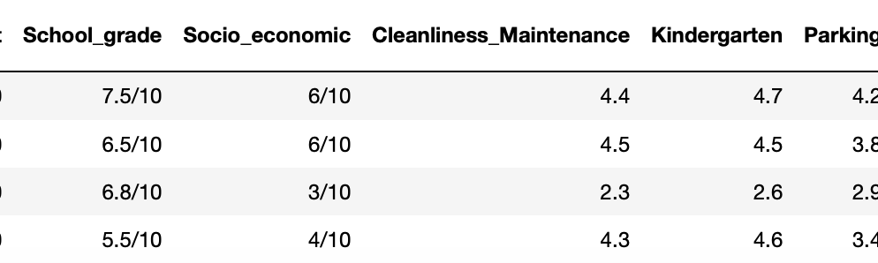
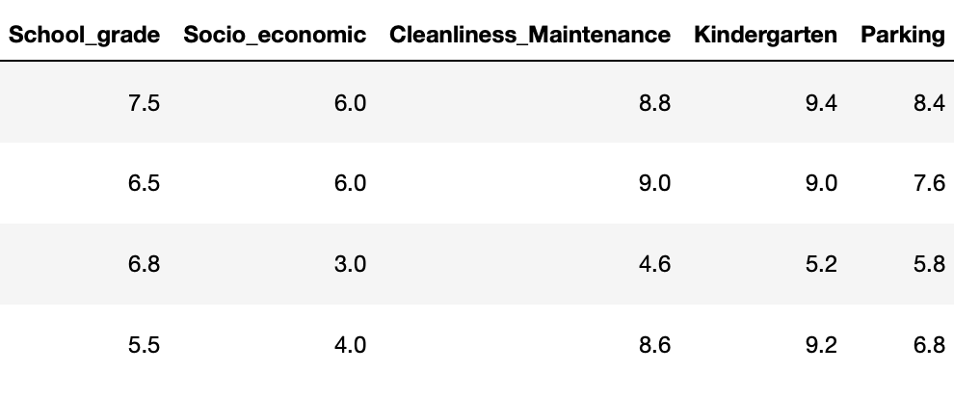
Regarding the data with the neighborhood ranking
Some of the data were rated 1 to 5 and some were rated 1 to 10
Now all ratings are 1 to 10

Slide 15

Part 3 - EDA

Slide 16
At this point I choose visualizations that will help a person decide if the apartment is suitable for investment? Is the apartment better for living?

Slide 17
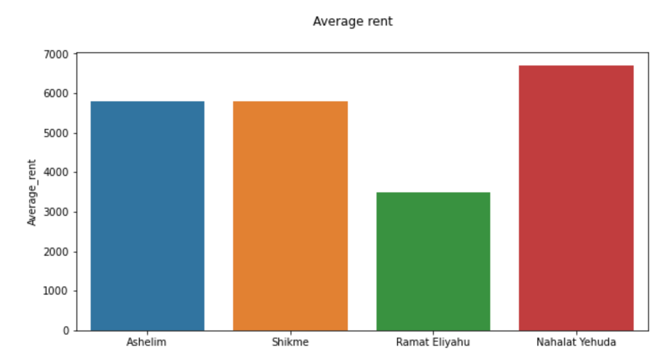
Data on neighborhoods characteristics

Slide 18
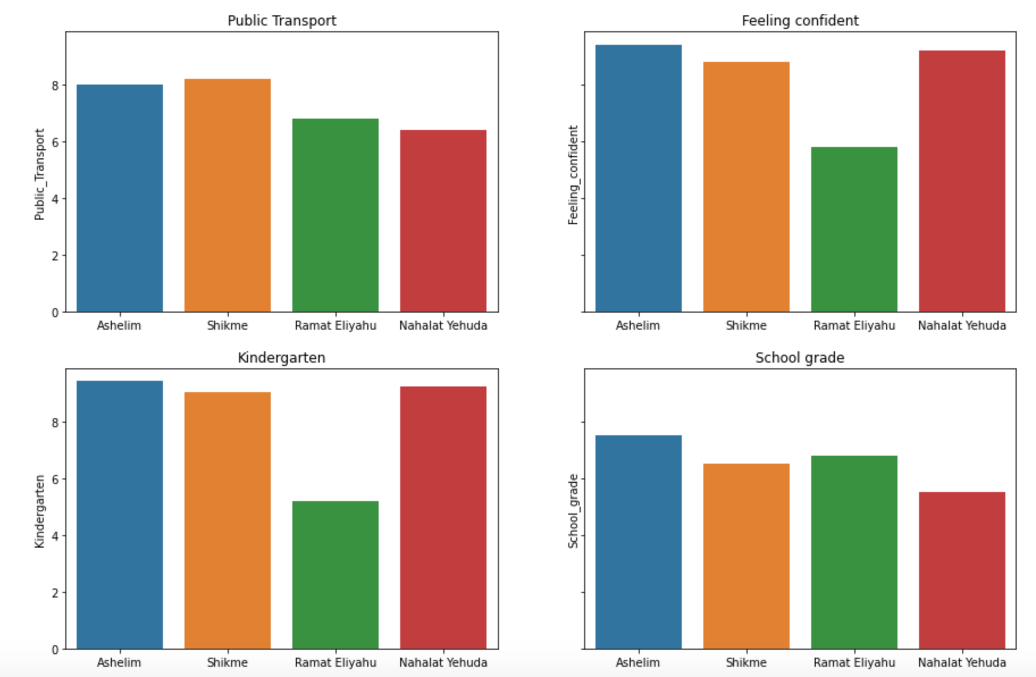
Ranking of neighborhoods in a variety of areas

Slide 19
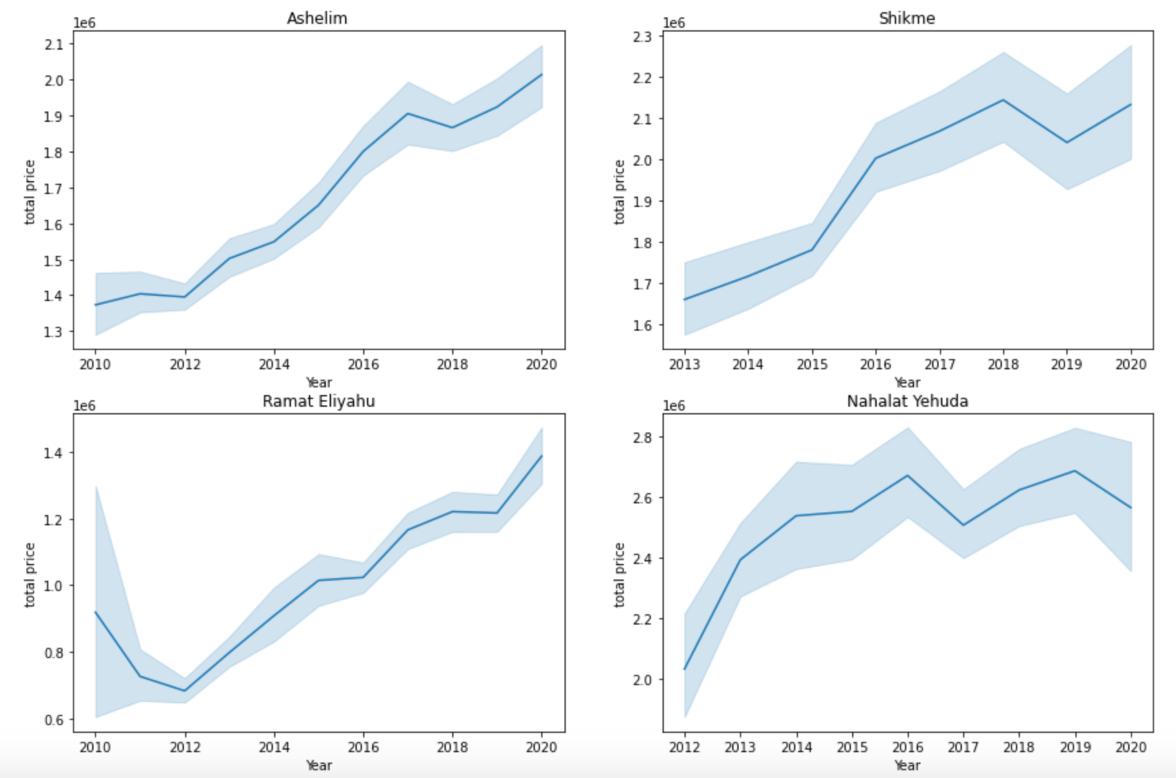
We will continue with Scatter Plot, which represents the rise in apartment prices by the year.

Slide 20
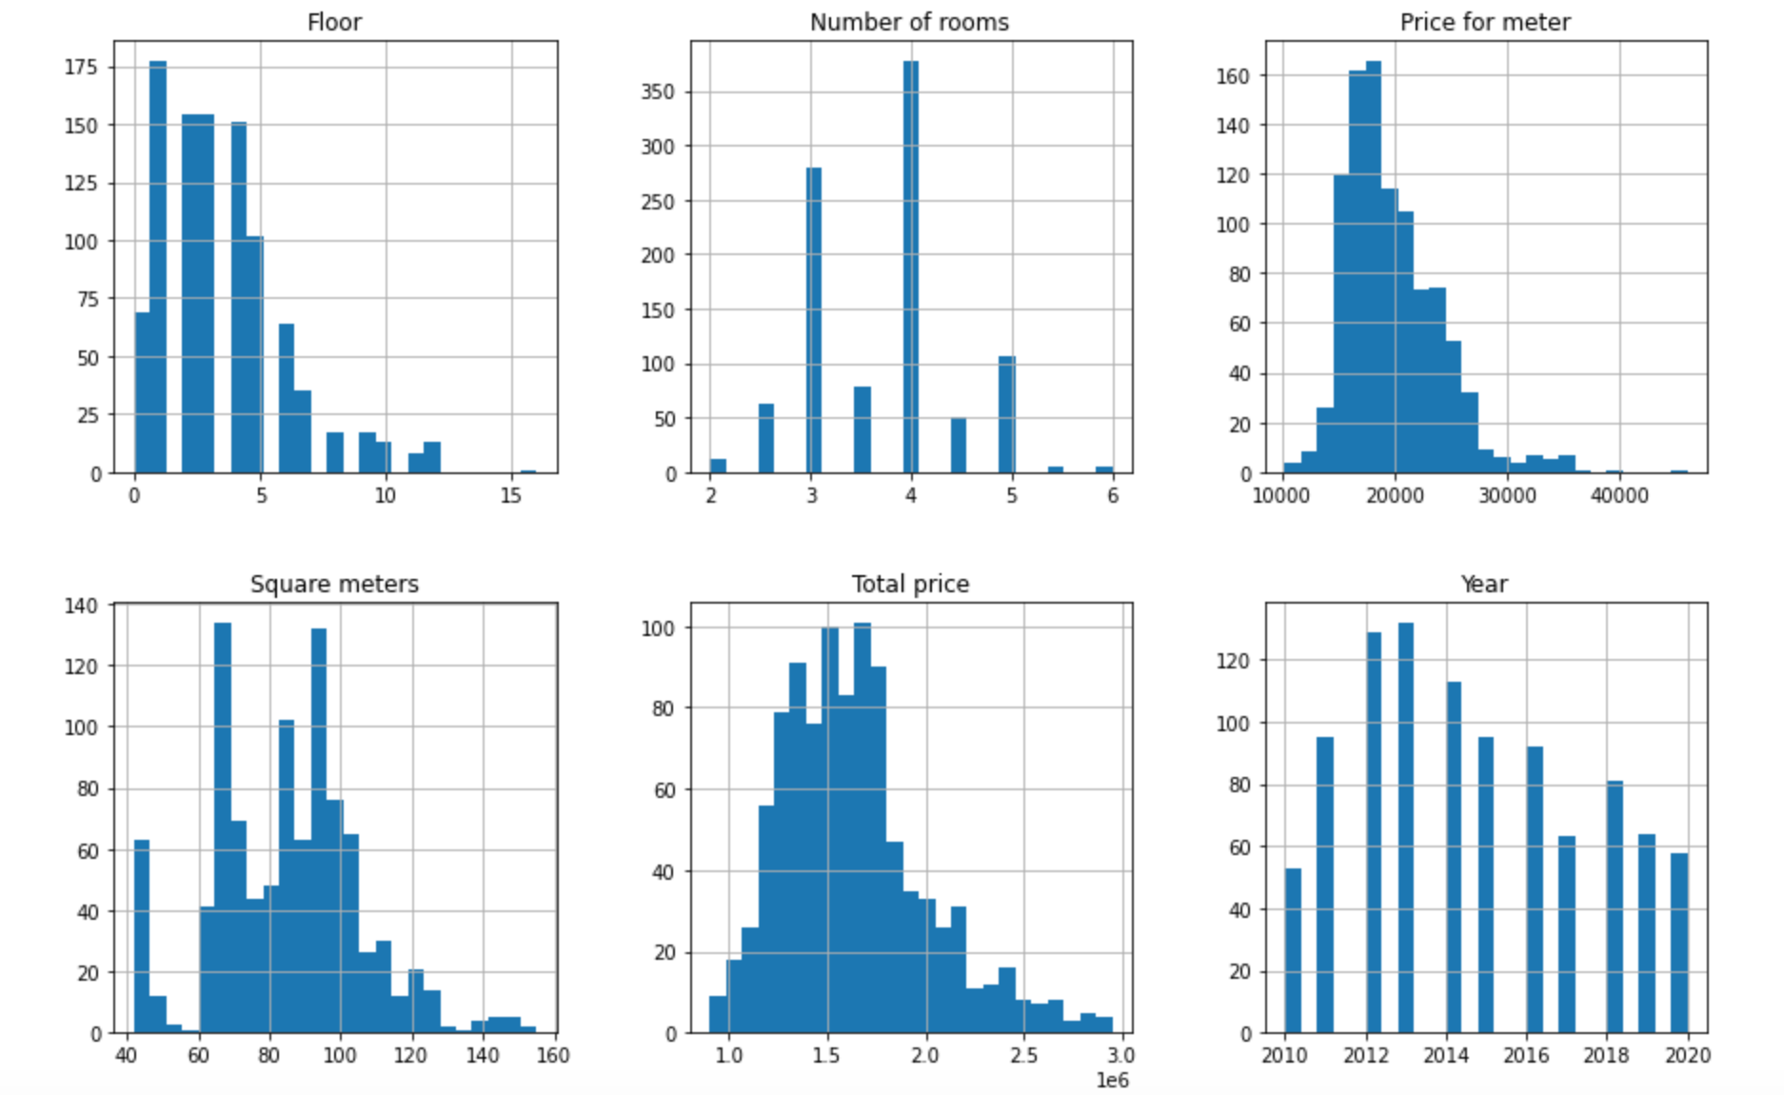
And we will end with a graphical analysis of the dataset columns
Ashelim

Slide 21

Part - 4 Machine Learning

Slide 22
ML – linear regression
In this part I built a model, based on data from the apartments from 2010, and accordingly anticipates its future price .
Some models were more successful, and some less. A model that predicted lower success - I performed actions to increase the chances of success.

Slide 23
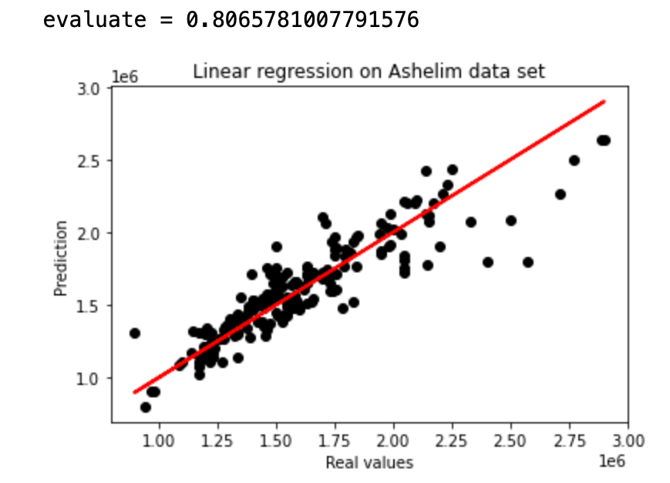
Scatter Plot that presents the model forecast against reality .

Slide 24
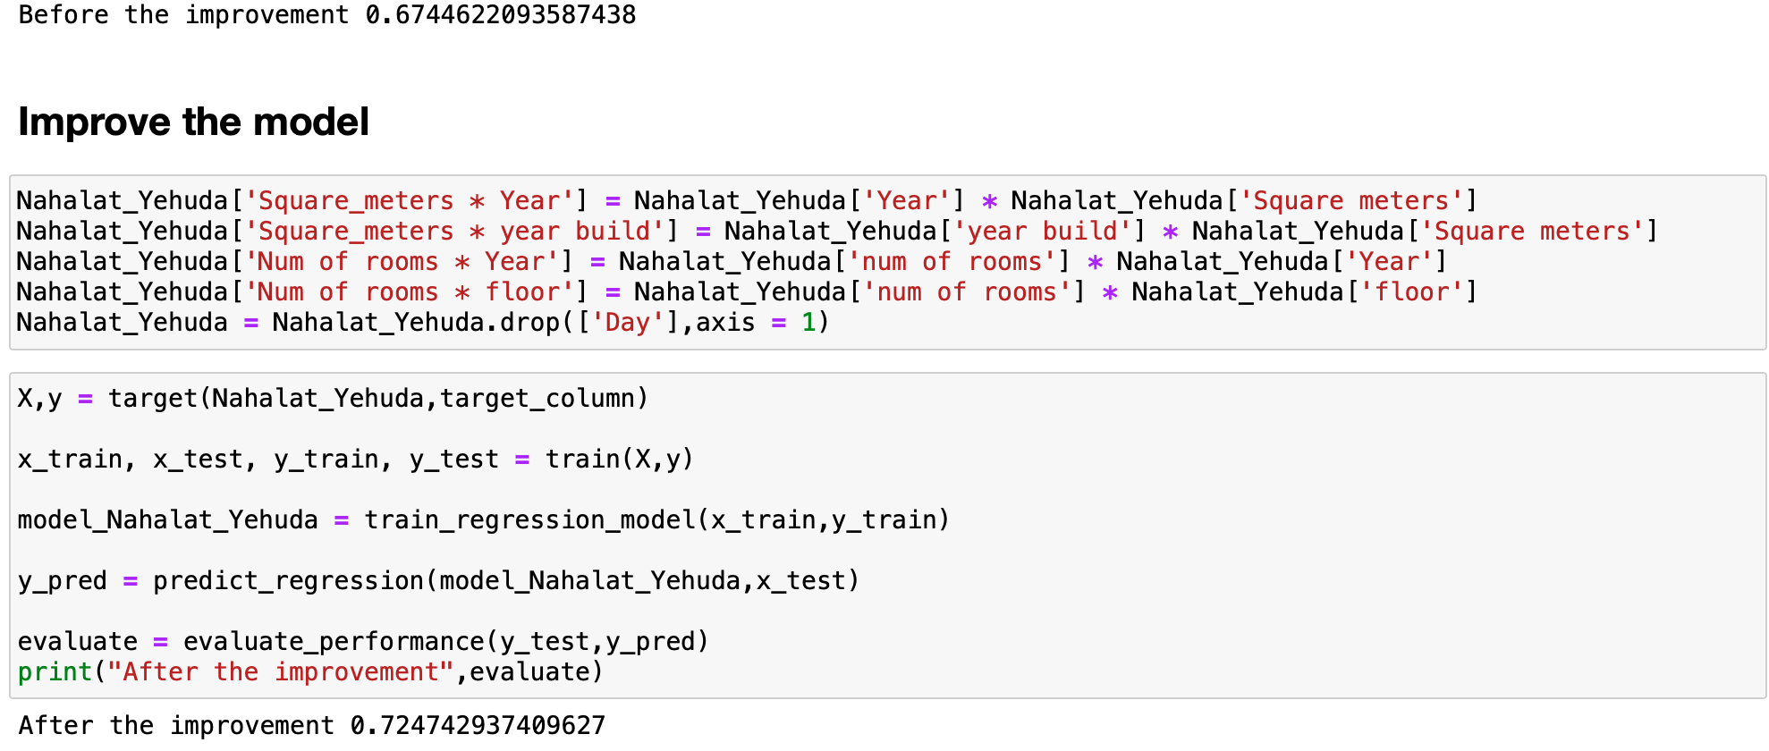
Improving the model - an example

Slide 25
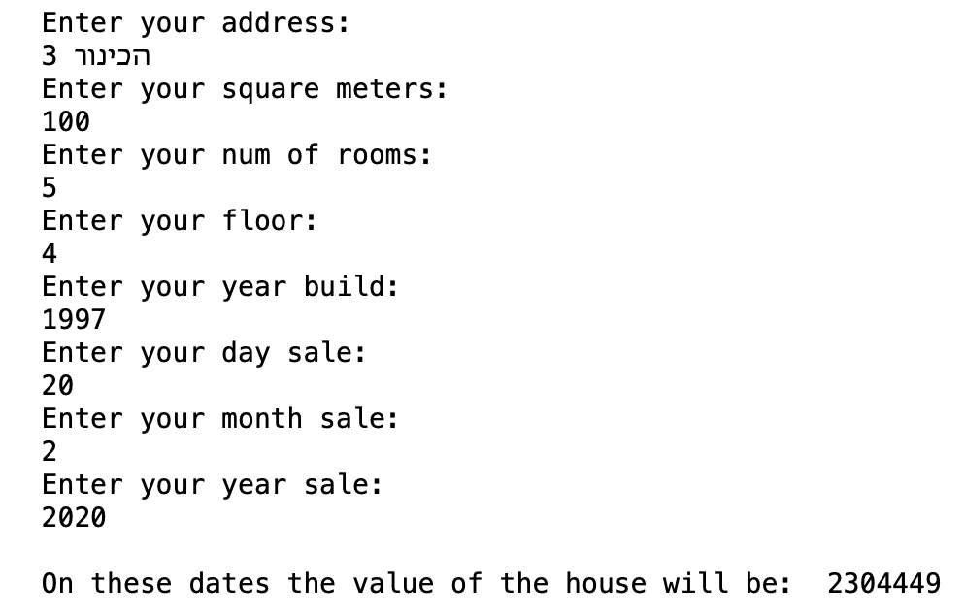
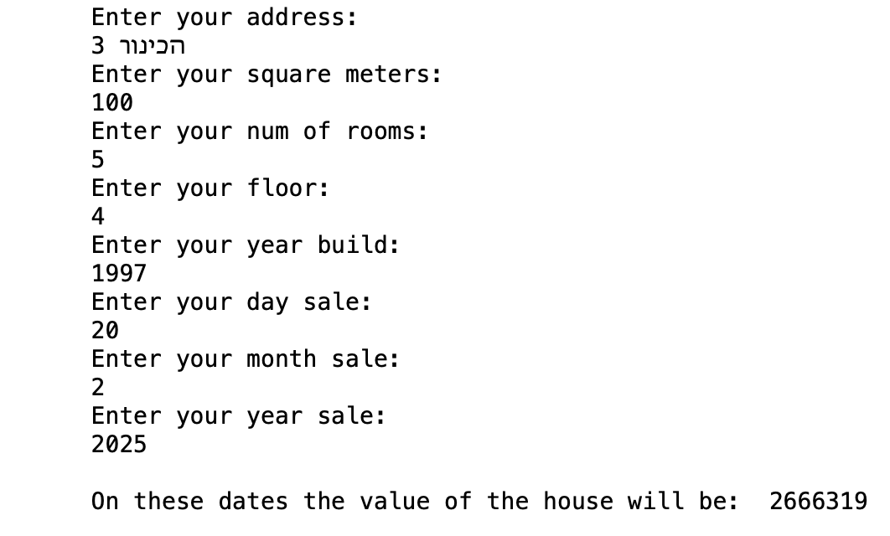
Now let's find out if it is worth buying the apartment for investment

Slide 26

Let me help you with the calculation
You can buy the house at 2,304,449 NIS
After 5 years you can sell it for 2,666,319 NIS
If we add the average rent to 11 months a year 11 * 5800 we will save another 63,800 NIS
We get an expected profit model of: 425,670 NIS

